Slide 1
New-Age Search through Apache Solr
View Apache Solr course details at www.edureka.co/apache-solr
For Queries:
Post on Twitter @edurekaIN: #askEdureka
Post on Facebook /edurekaIN
For more details please contact us:
US : 1800 275 9730 (toll free)
INDIA : +91 88808 62004
Email Us : sales@edureka.co

Slide 2
Objectives
At the end of this module, you will be able to understand:
The need for search engine for enterprise grade applications
The objectives & challenges of search engine
How is Indexing & Searching Handled in Lucene
Solr and its Architecture
Near Real Time Search with Solr
SolrCloud
Leveraging Solr Capabilities with Hadoop
Solr with YARN
About job opportunity for Solr Developers

Slide 3
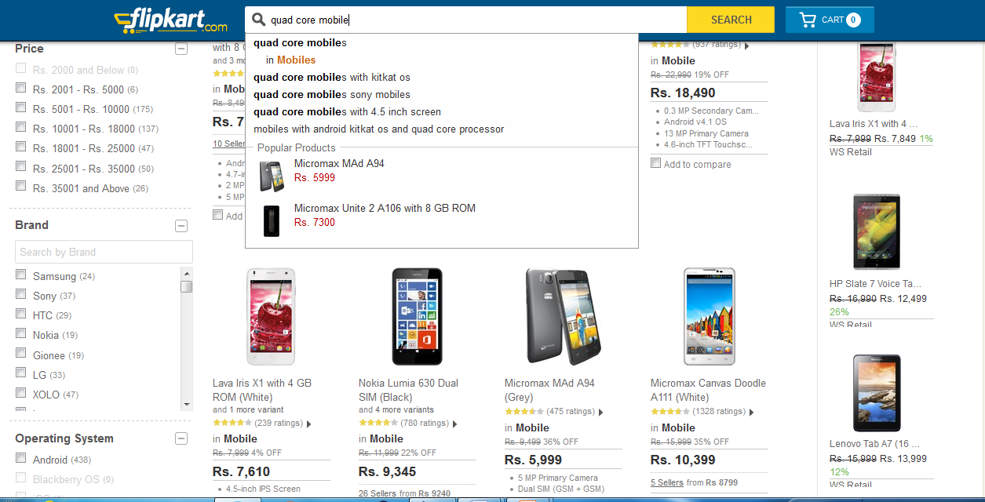
Why Do I Need Search Engines ?

Slide 4
Search Engine: Why do I need them?
1
2
1. Text Based Search
2. Filter
3. Documents
3

Slide 5
Search Engine – What it should be?
If you need a storage engine to search records / documents using text-based keywords it should support following features:
Should be optimized for faster text searches
Should have flexible schema
Should support sorting of documents
Web Scale - Should be optimized for reads
Should be document oriented

Slide 6
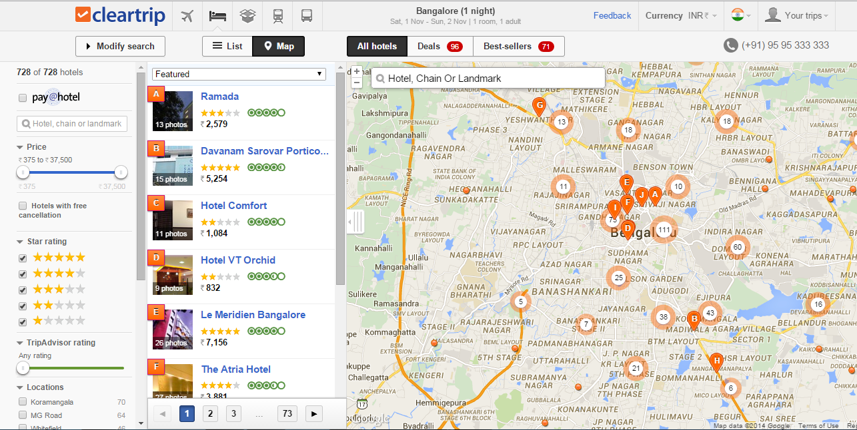
Cleartrip Spatial Search

Slide 7


What is Lucene ?
Lucene is a powerful Java search library that lets you easily add search or Information Retrieval (IR) to applications
Used by LinkedIn, Twitter, … and many more (see http://wiki.apache.org/lucene-java/PoweredBy )
Scalable & High-performance Indexing
Powerful, Accurate and Efficient Search Algorithms
Cross-Platform Solution
Open Source & 100% pure Java
Implementations in other programming languages available that are index-compatible
Doug Cutting “Creator”

Slide 8

Indexing – How it works?
Document - 1 (“D1”)
Document - 2 (“D2”)
Document - 3 (“D3”)
I like edureka courses
Edureka teaches big data courses
Edureka helps learn new technologies easily
“edureka” = {D1, D2, D3}
“courses” = {D1, D2}
“teaches” = {D2}
“big” = {D2}
“data” = {D2}
“helps” = {D3}
“edureka”

Slide 9
Lucene – Writing to Index
Document
Field
Field
Field
Field
Directory
Analyzer
IndexWriter
Classes used when indexing documents with Lucene

Slide 10
Lucene – Searching In Index
Query Parser translates a textual expression from the end into an arbitrarily complex query for searching
QueryParser
Query object
IndexSearcher
Expression
Text fragments
Analyzer

Slide 11
What is Solr ?
Solr is an open source enterprise search server / web application
Solr Uses the Lucene Search Library and extends it
Solr exposes lucene Java API’s as RESTful services
You put documents in it (called "indexing") via XML, JSON, CSV or binary over HTTP
You query it via HTTP GET and receive XML, JSON, CSV or binary results

Slide 12
Solr: Key Features
Advanced Full-Text Search Capabilities
Optimized for High Volume Web Traffic
Standards Based Open Interfaces - XML, JSON and HTTP
Comprehensive HTML Administration Interfaces
Server statistics exposed over JMX for monitoring
Near Real-time indexing and Adaptable with XML Configuration
Linearly scalable, auto index replication, auto, Extensible Plugin Architecture

Slide 13
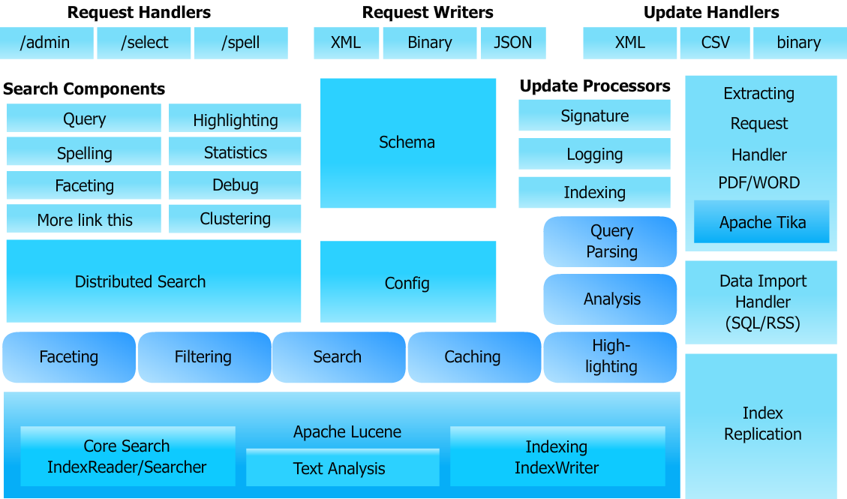
Solr: Architecture

Slide 14

Solr: Search Process
qt: selects a RequestHandler for a query using/select(by default, the DisMaxRequestHandler is used)
Request Handler
defType : selects a query parser for the query
(by default, uses whatever has been configured for the RequestHandler)
Response Writer
wt: selects a response writer for formatting the query response
Query Parser
qf: selects which fields to query
in the index(by default, all fields are required)
fq: filters query by applying an additional query to the initial query’s results, caches the results
 | Index
Rows: specifies the number of rows to be displayed at one time
Start: specifies an offset(by default 0) into the query results where the returned response should begin

Slide 15
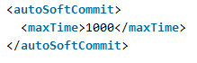
Near Real-Time Search
Near Real Time (NRT) search means that documents are available for search almost immediately after being indexed: additions and updates to documents are seen in 'near' real time
http://localhost:8983/solr/update?stream.body=<add><doc><fieldname="id">testdoc</field></doc></add>&commit=true

Slide 16
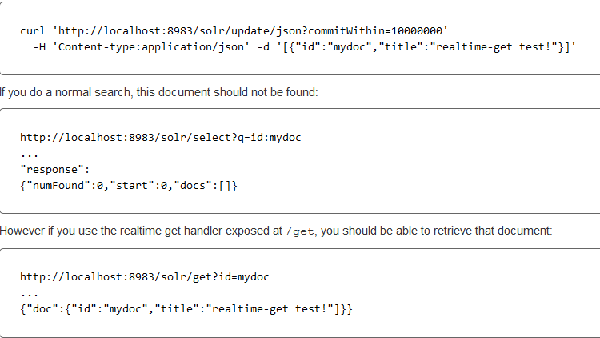
Real-Time Get
The realtime get feature allows retrieval (by unique-key) of the latest version of any documents without the associated cost of reopening a searcher
This is primarily useful when using Solr as a NoSQL data store and not just a search index

Slide 17
SolrCloud
Apache Solr includes the ability to set up a cluster of Solr servers that combines fault tolerance and high availability called SolrCloud
SolrCloud is flexible distributed search and indexing, without a master node to allocate nodes, shards and replicas
Solr uses ZooKeeper to manage these locations, depending on configuration files and schemas
Documents can be sent to any server and ZooKeeper will figure it out

Slide 18
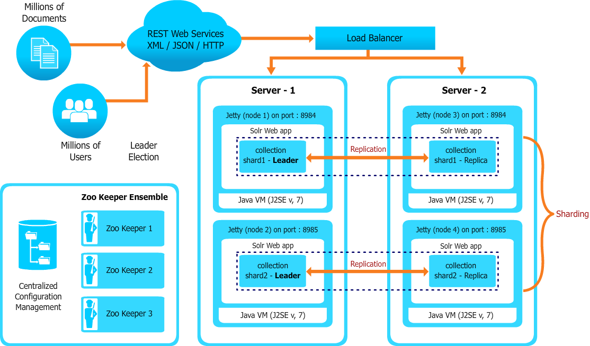
Architecture

Slide 19
Leveraging Solr Capabilities with Hadoop
Solr provides us fast, efficient, powerful full-text search and near real-time indexing and SolrCloud is flexible distributed search and indexing, and will do things like automatic fail over etc.
Hence its very suitable as NoSQL replacement for traditional databases in many situations, especially when the size of the data exceeds what is reasonable with a typical RDBMS
We can do scalable indexing using Hadoop MapReduce or PIG job and then load the indexed data in Solr
In all the major Hadoop distribution like Cloudera, Hortonworks, MapR you can integrate Solr easily

Slide 20


Scalable Indexing
Search Web App
HDFS
(Hadoop Distributed File System)
Query
Response
PDF
Raw Files
Word
SolR
SolR
SolR
HTML
. . .
Lucene
Input Data
Raw Files
Indexed
MapReduce Indexing Job

Slide 21
Solr with YARN
YARN NodeManager
YARN Container
Solr YARN Client
1
YARN ResourceManager
2
Solr AppMaster
3
ZooKeeper
5
4
YARN NodeManager
YARN Container
YARN Container
HDFS
Solr-yarn.jar
Solr.tgz
Solr Index
Solr
Spark

Slide 22

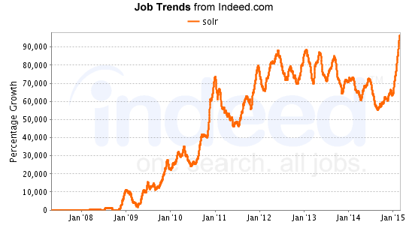
Job trends for Apache Solr

Slide 23
How it Works?

